Slide 1
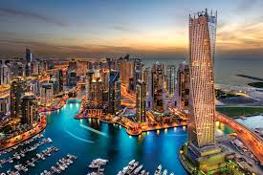
Dubai

Slide 2
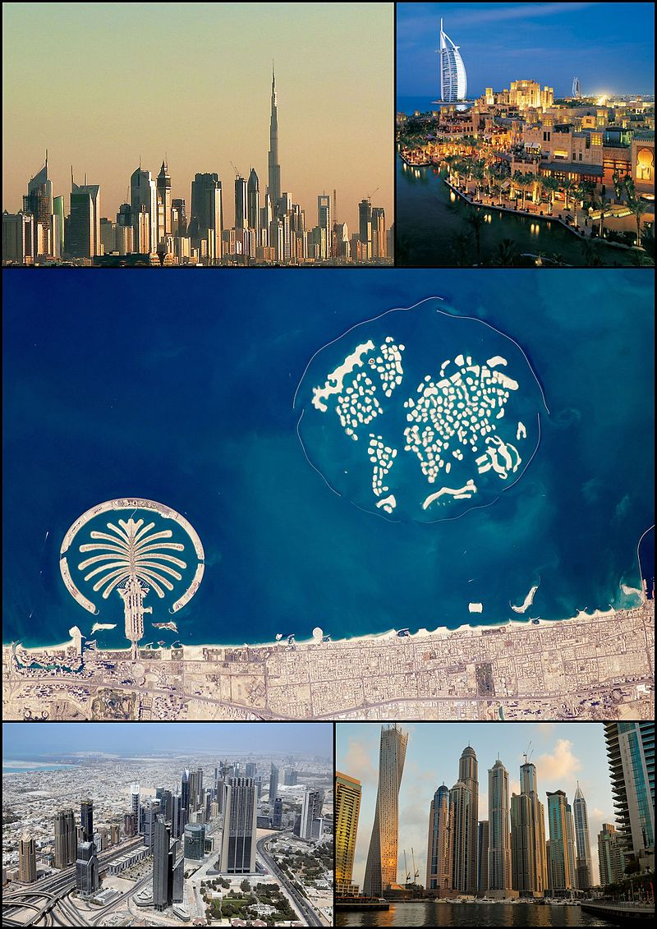
Dubai
Dubai is a capital of Emirates of Dubai

Slide 3
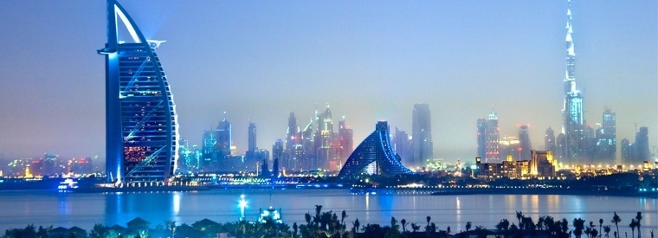
Today it's the city for many tourists from the tops of world’s elite.

Slide 4
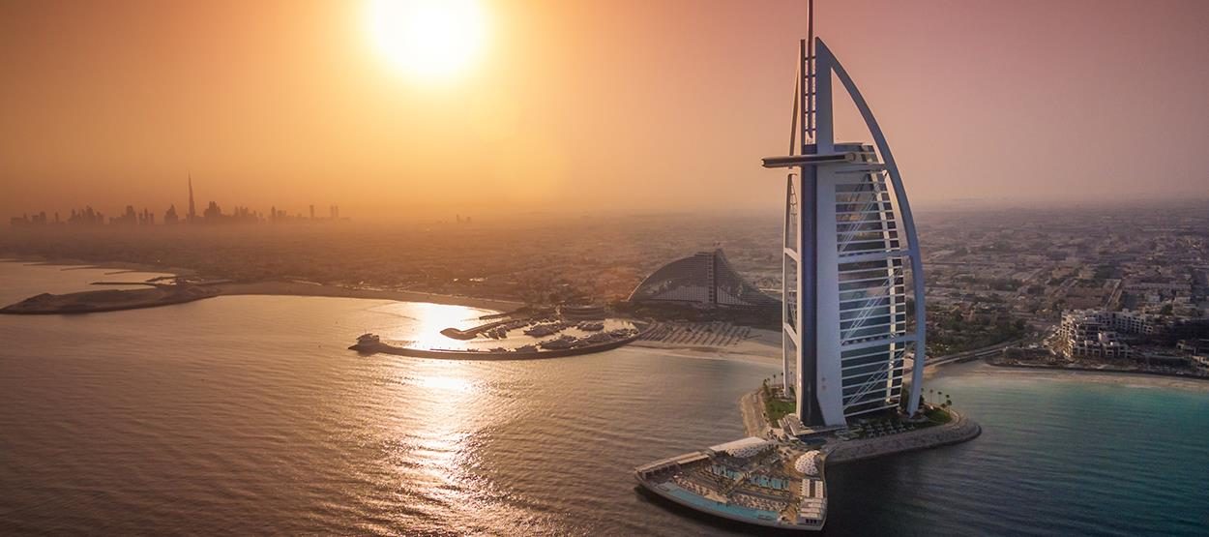
hotel Burj Al Arab
Burj Al Arab is one of the most luxurious and most expensive hotels in the world.
It is the only hotel with 7 stars.

Slide 5
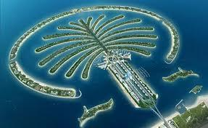
Peninsula in the form of palm trees
On the peninsula is built apartments, hotels, water parks, shopping centers and airports.

Slide 6
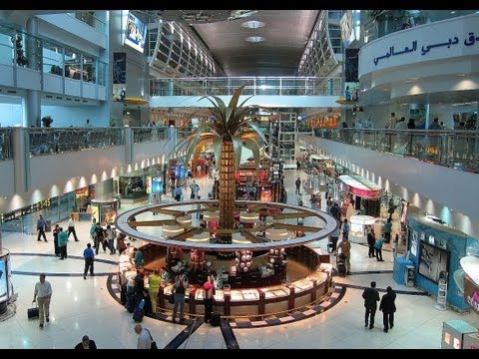
Dubai mall
Dubai Mall is one of the largest shopping centers in the world.

Slide 7
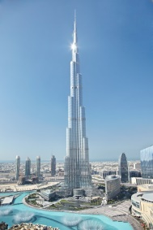
Burj dubai
The highest skyscraper in the world.

Slide 8
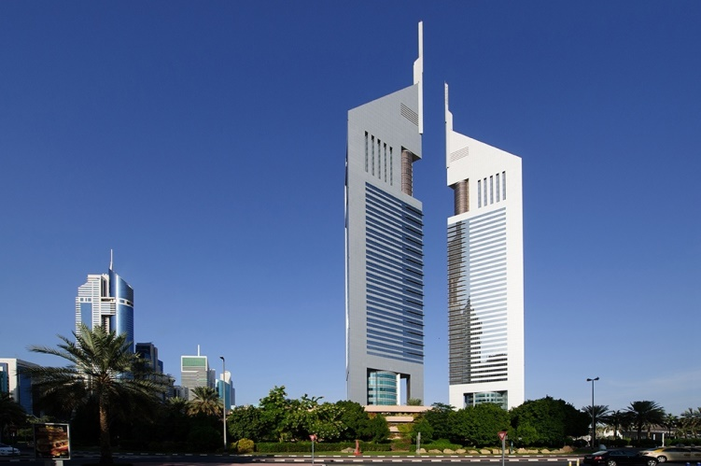
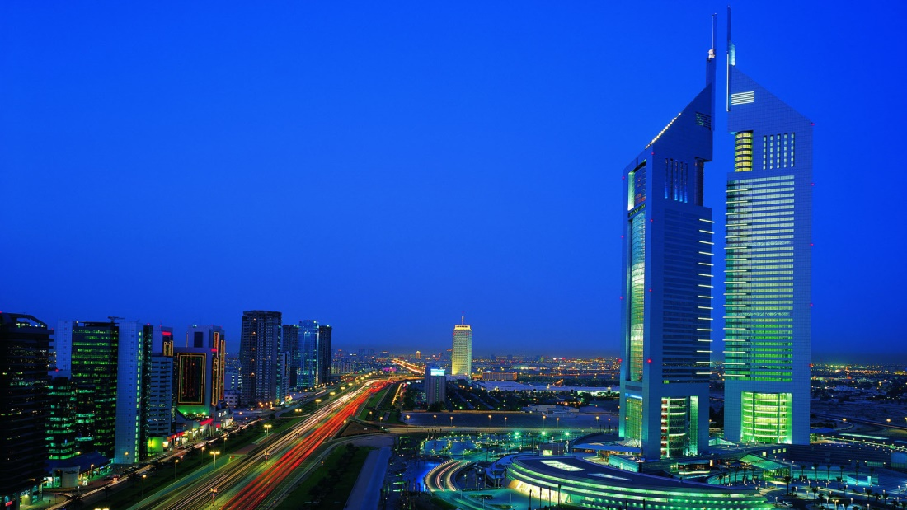
The Emirates Towers
Jumeirah Emirates Tower Hotel.
Emirates Office Tower

Slide 9
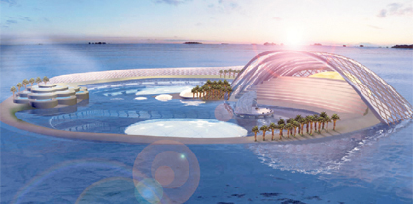
Dubai marinA
Dubai Marina is an artificial canal city.

Slide 10
presentation prepared by: Antonija furmeg 7.a .

