Slide 1
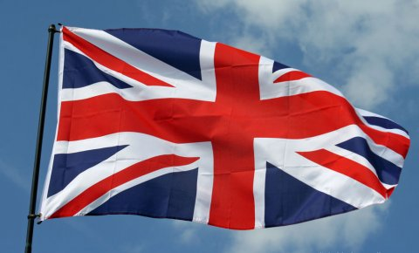
LONDON

Slide 2
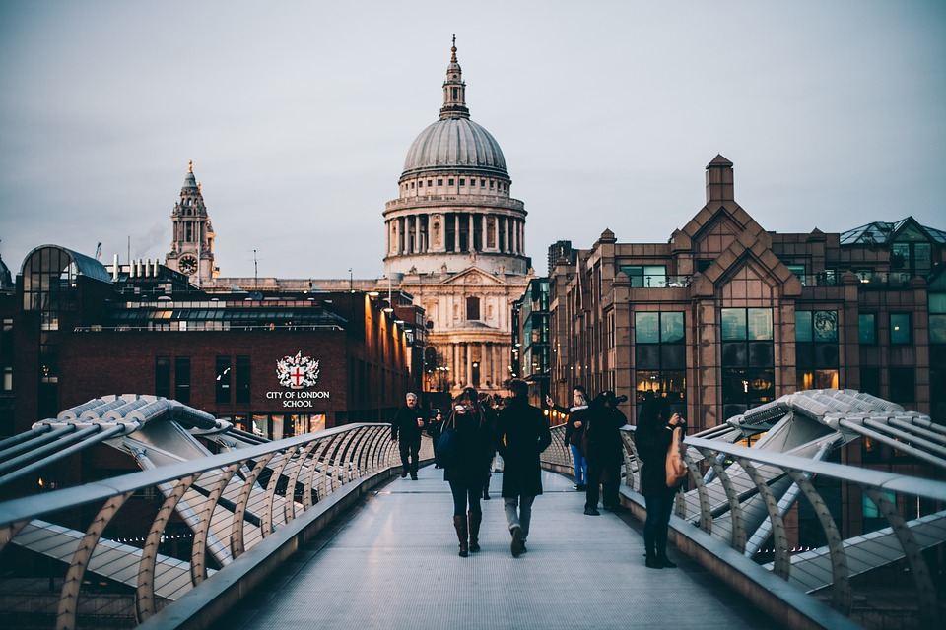
London
London is the capital of England and the UK.
London is the world-leading city particularly in the arts.
There are about 8,539 people.
London is a tourist center.

Slide 3
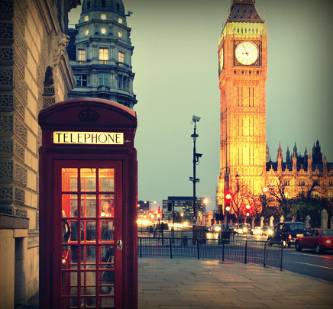
BIG BEN
●Big Ben, the big clock tower, is the symbol of London. It strikes hours.

Slide 4
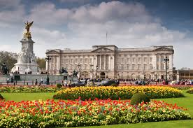
Buckingham Palace
This is the Queen’s home.
It was built in 1703.
There is a great collection of paintings.

Slide 5
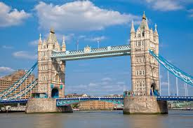
Tower Bridge
Tower Bridge is a bascule-bridge.
The bascules will open to let ships pass through.

Slide 6
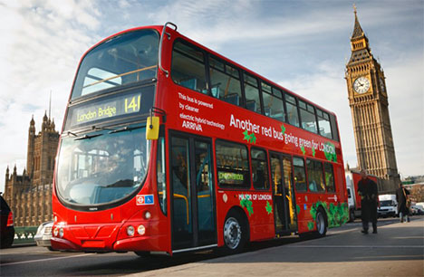
Double-deckers
There are big red buses called double-deckers in London.
People sit upstairs and downstairs on these buses.
Tourists like them very much.

Slide 7
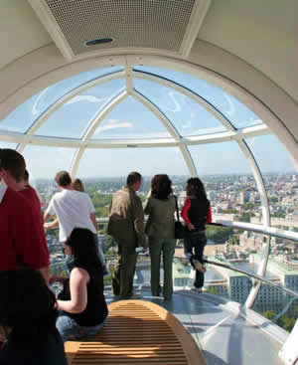
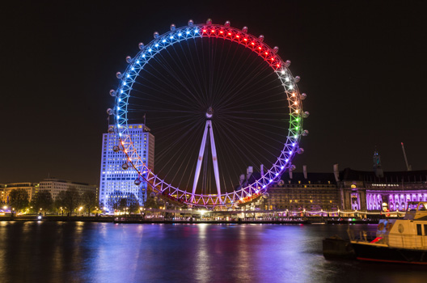
London eye
London Eye from outside…
…and from inside

Slide 8
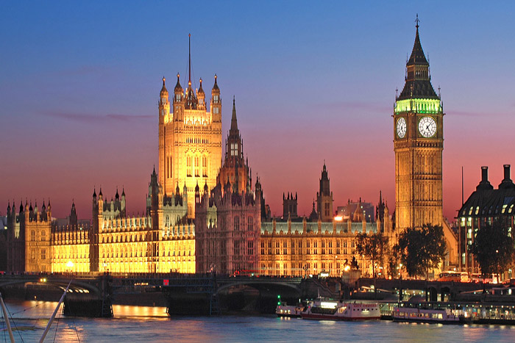
The Houses of Parliament
This big palace is the most famous building in the world – the British Parliament.
The building is 280 metres long.
There are more than 1000 rooms.

Slide 9
THE END By:Katarina Ifšak 7a

