Slide 1
Los
Angeles

Slide 2
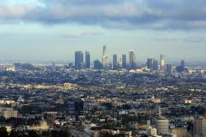
About
Los Angeles is also known as L.A.
L.A. is a big city in South California.
It is also called „City of Angels”.
Hollywood is a part of L.A.
Hollywood is recognizable by lots of famous movies, video games and music.

Slide 3
Famous sights in L.A.
In L.A. you can see lots of famous sights.
You can visit:
famous record label
a big „Hollywood” sign
Angels Flight theater
Staples Center
and more.

Slide 4
Capitol Records is the most famous record label in Hollywood.

Slide 5
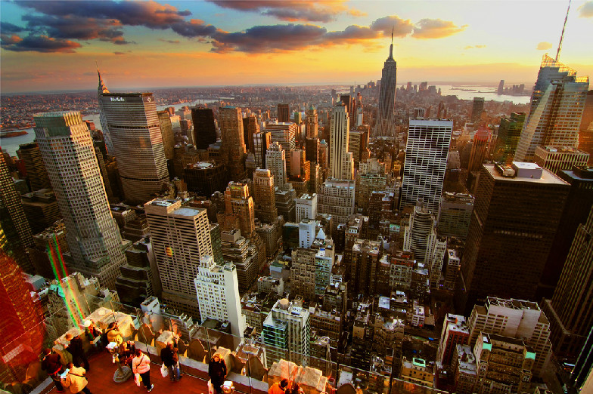
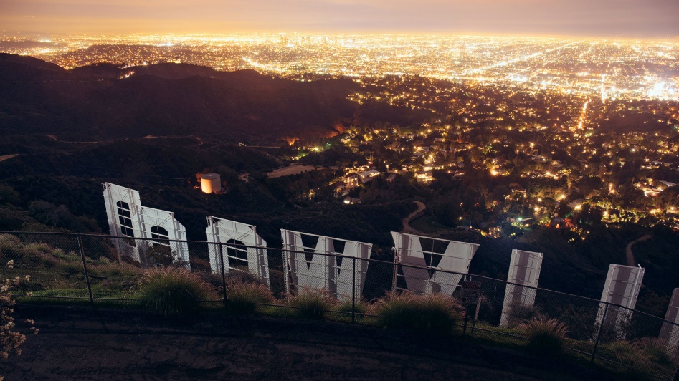
This is famous part of Los Angeles called Hollywood.
This sign is a symbol of Hollywood.

Slide 6
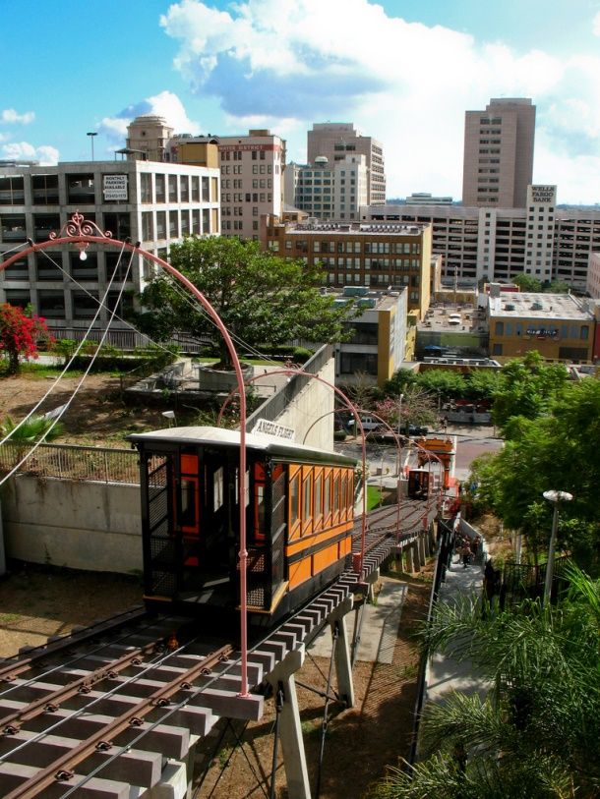
Staples Center is a big sports hall. There you can see a lots of sport competitions and also concerts.
Angels Flight theater is a theater for kids.

Slide 7
In Los Angeles you can visit beautiful beaches where you can take a walk, swimm, rest and have lots of fun.

Slide 8
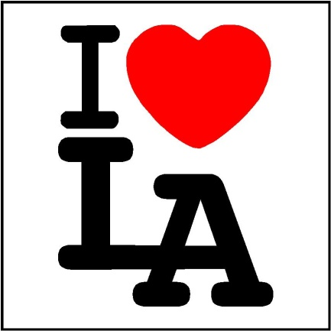
I like this city because it is very nice, I can see a lots of interesting places. Many famous actors and singers live there. It looks very beautiful on pictures. Lots of TV series and movies mentioned L.A., also series and movies are filmed there.
By: Lucija Biljan 7.b

