Slide 1
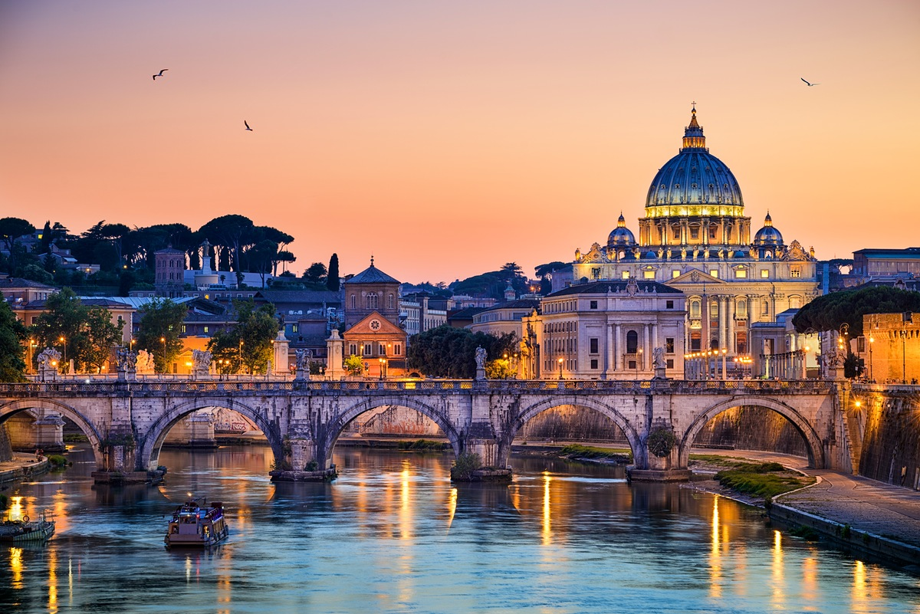
Rome

Slide 2
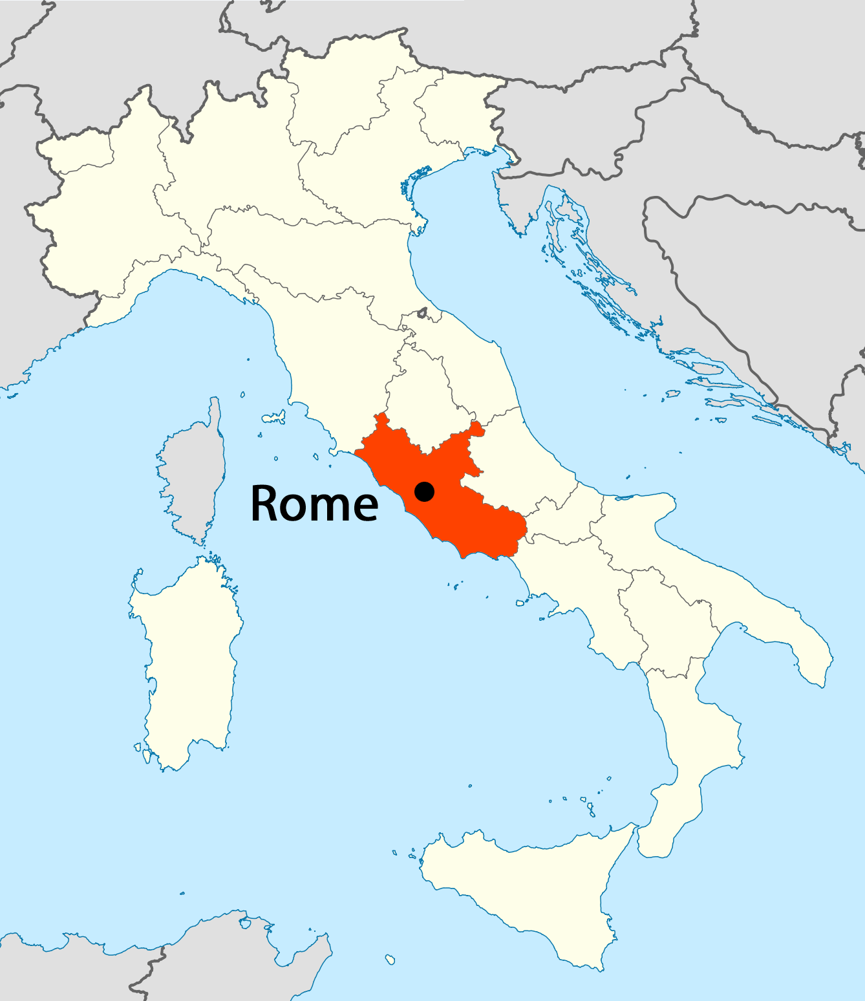
About Rome
Rome is the capital of Italy and Lazio regions, and the largest and most populated city in the country.
It has 2.612.068 residents by the list from 2011.
Nicknames of the city are: ”Capital of the world”, ” Eternal city”, „Apostolic threshold” and „The city on seven hills”.

Slide 3
Famous sights
Colosseum
Fontana Di Trevi
St. Peter's Basilica

Slide 4
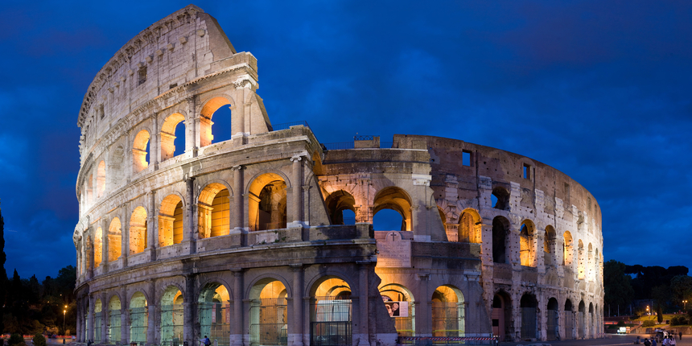
Colosseum
Colosseum is an oval amphitheatre in the centre of the city.
It’s built of concrete and sandand it is the largest amphitheatre ever built.
Named after the colossal statue of the Emperor Nero.
The Colosseum could hold, it is estimated, between 50,000 and 80,000 spectators.

Slide 5
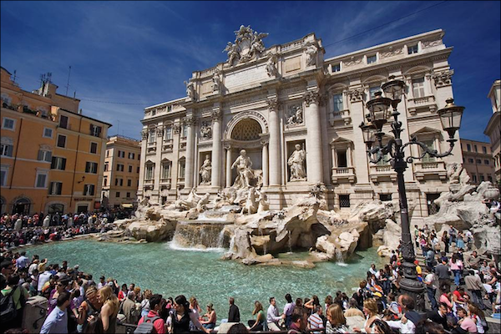
Fontana Di Trevi
Fontana di Trevi is situated in the district of Trevi in Rome.
Height of 26.3 m and a width of 49.15 m it is the largest Baroque fountain in the city and one of the most famous in the world.
According to legend, you throw a coin in the fountain, you will return back to Rome.
On the first level of the fountain is a relief of a young girl after which the aqueduct named.
It was named after the little girl who showed the Agrippa the water source

Slide 6
St. Peter's Basilica
St. Peter's Basilica is the Vatican church built in the style of classical Renaissance, the site of a previous early Christian basilica.
He believes it is a unique church in the Christian world, and most important of all Christian churches. Above the tomb of St. Peter, in the 16th century, built the beautiful basilica in his honor.
Many famous artists of Italy, including Donato Bramante, Gianlorenzo Bernini and Michelangelo were involved in its construction from 1506. to 1626.

Slide 7
THE END
Made by: Dominik Pugar
Class: 7.b

