Slide 1
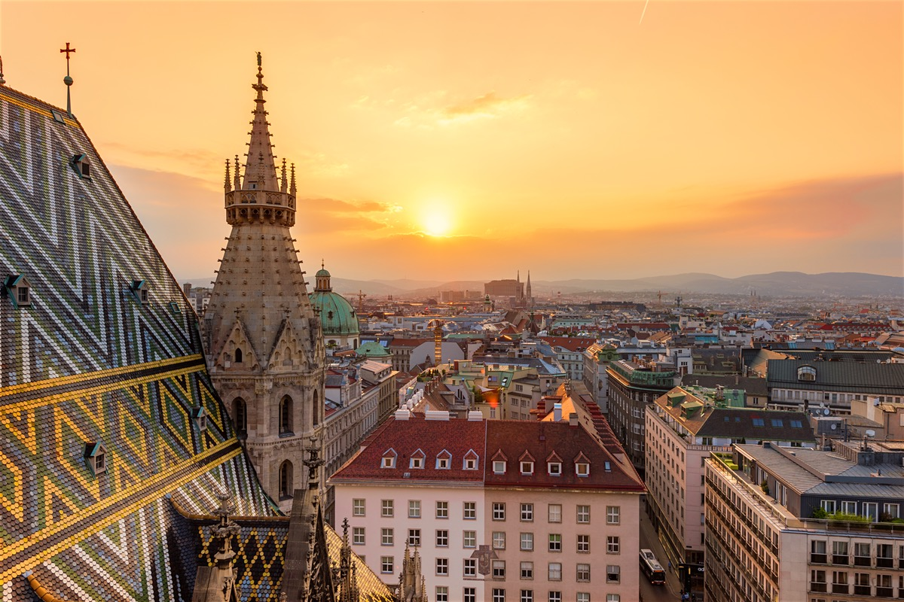
VIENNA

Slide 2
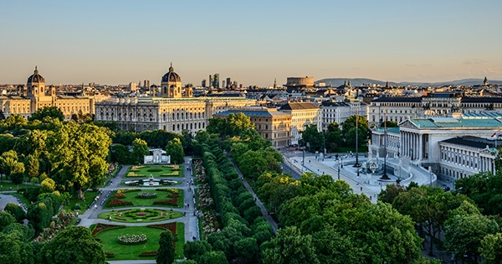
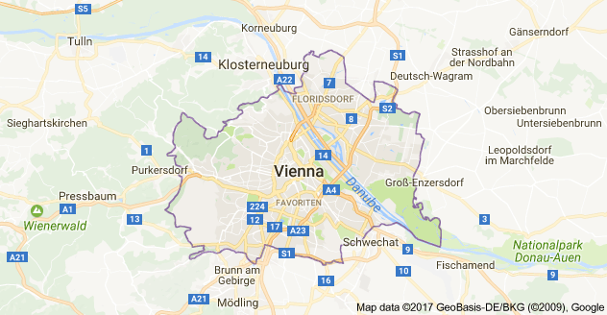
Vienna is the capital city of Austria. Vienna is a beautiful city,with a population of
about 1.8 million and it’s cultural, economic, and political centre.
Vienna is called as ’’City of Music’’ and ‘’The city of dreams.’’
In Vienna you can see:

Slide 3
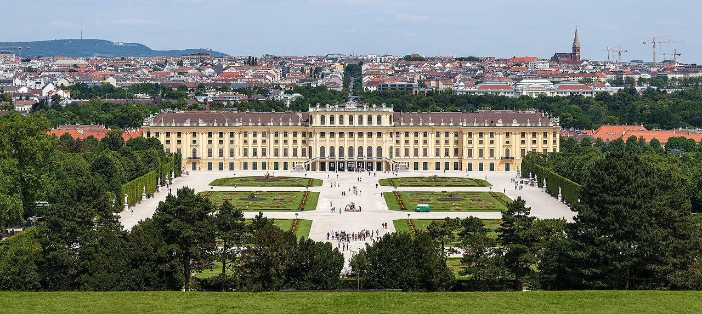
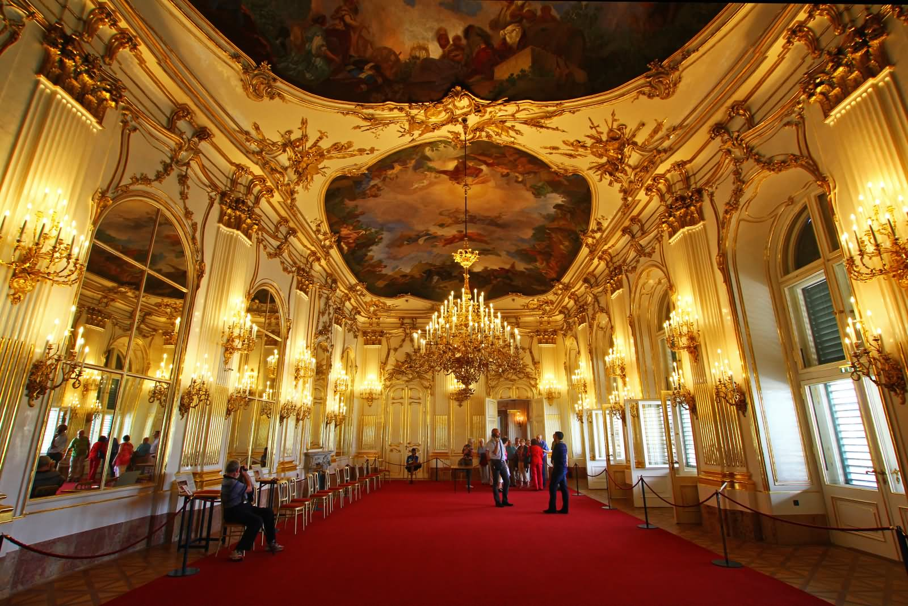
Schönbrunn Palace
Schönbrunn Palace is Baroque palace. One of the most important cultural and historical monuments in the country. Since 1950s it has been a tourist attraction. The history of the palace and it’s big gardens spans over 300 years.

Slide 4
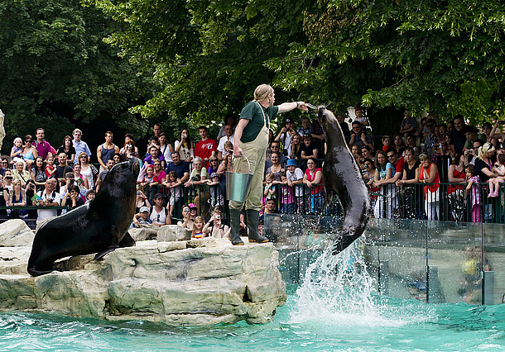
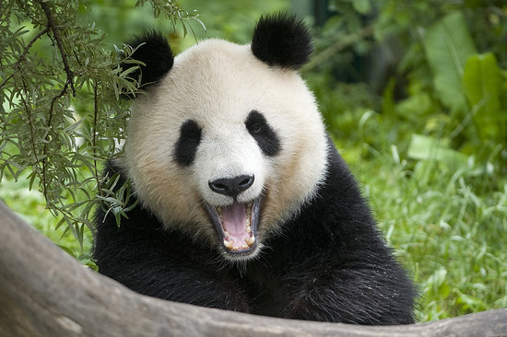
Tiergarten Schönbrunn
Tiergarten Schönbrunn or "Vienna Zoo", is a zoo located on the grounds of the famous Schönbrunn Palace.It is the oldest zoo in the world.With more than 500 different animals and you can see the different wild cats, elephants, pandas, koalas, different types of penguins...

Slide 5
Hofburg
The Hofburg is the palace in the centre of Vienna.
It was built in the 13th century.Today Hofburg is the workplace of the President of Austria.

Slide 6
St. Stephen's Cathedral
St. Stephen's Cathedral is the Catholic church. It was built in the Romanesque and Gothic style. It's 136 m high .

Slide 7
Austrian Parliament Building
The parliament building covers over 13,500 meters and it's one of the biggest building.Today it is the seat of the Austrian Parliament. In the palace are held all important state ceremonies.
The fountain in front of the Parliament building.

Slide 8
Rathaus
Rathaus is the city hall of Vienna. Construction costs amounted to a total of about 14 million gulden.
Rathaus is the seat of mayor of Vienna.

Slide 9
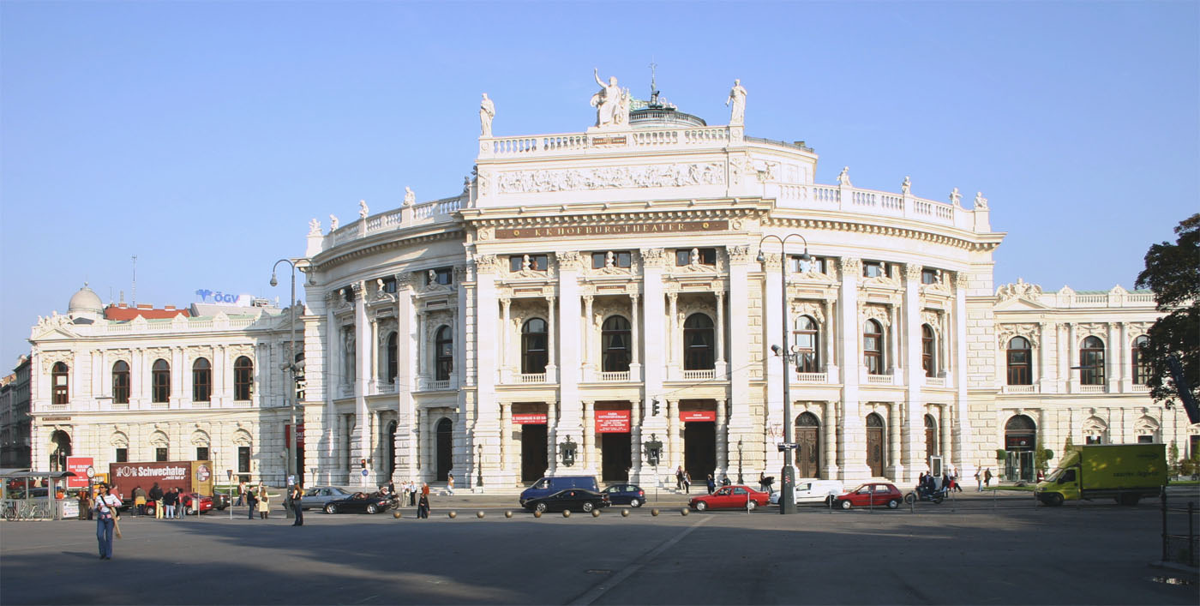
Burgtheater
Burgtheater is one of the attractions and one of the most important stage. It's situated in the center of Vienna near the city hall.

Slide 10
END
Presentation made by: Ela Bagaj

